Slide 1
The French Banking Sector, Arab banks and Iraq
Dr Estelle Brack
Economic and Banking Conference
Bagdad, 11/01/2013

Slide 2
According to the IMF “Iraq’s reconstruction requires not only the rebuilding of its infrastructure, but also of its economic and social institutions and the creation of a business environment that attracts capital and brings with it new technology and skills to modernize the economy.”
IMF advice has centered on “modernizing the financial sector to enable the private sector to develop“, mainly by “enhancing Central Bank of Iraq (CBI) operations and promoting a banking sector that can provide basic financial services, including, crucially, to the private sector.”

Slide 3
How to promote “a banking sector that can provide basic financial services, including, crucially, to the private sector”?
There is a paragraph dedicated to financial service is the cooperation agreement signed a year ago between the Iraqi and French authorities
One possibility often raised to me is to open foreign branches of European banks in Iraq to foster competition and, thus, develop financial integration.
No doubt that the French banking sector has a good and rich experience (and best practices) to share, but that Arab banks are also appropriate stakeholders in that matter : they have local knowledge and they are already present.

Slide 4
The French banking system at a glance
A stable & solid model
Arab banks

Slide 5
The French banking system at a glance
A stable & solid model
Arab banks

Slide 6
The French banking system at a glance
A single licence : under the so-called banking monopoly rule, banking services can only be offered on a regular basis by companies licensed as credit institutions.
  The rule has been set out by the Banking Act of January, 1984, as amended by the law of 16th July, 1992, implementing the Second European Union Banking Directive (December, 1989) and the law of 2nd July, 1996, implementing the EU Investment Service Directive (May, 1993).

Slide 7
The French banking system at a glance
High quality of oversight and prudential supervision
  The new Prudential Control Authority (ACP - Autorité de contrôle prudentiel) for Banking and Insurance activities
  The Banking and Financial Regulatory Committee (CRBF - Comité de réglementation bancaire et financière) lays down the regulations governing credit institutions.
  The Financial Market Authority (AMF - Autorité des marchés financiers) combined these three responsibilities (regulation, authorization and supervision) for investment services activities

Slide 8
The French banking system at a glance
The Federation has very good relations with regulators and supervisors
  FBF is member of regulatory and supervisory committees (CECEI for example) as well as of self regulation bodies (CCSF - Consultative committee on financial services)
  Member of High Level Committees ad hoc like “High Committee for Paris Financial Center”
  High quality regular meetings with regulatory and supervisory bodies: Banque de France, ACP, AMF
  Is an involved stakeholder in the better regulation and consultation processes

Slide 9
The French banking system at a glance
A comprehensive banking model
  Banking groups with diversified activities tailored to all customer segments
    Retail banking, investment banking and capital markets, asset management, payment instruments
  The system is dominated by five vertically integrated universal banks and their subsidiaries
    BNP Paribas, Société Générale
    Three of the five are organized on a mutual basis (Crédit Agricole, Crédit Mutuel-CIC, BPCE)
    Two large financial institutions, La Poste and the Caisse des Dépôts et Consignations (CDC), remain in government ownership.
    These groups control 83% of all assets

Slide 10
The French banking system at a glance
Most of French banks belong to the « universal banking » model: diversification of business lines serves to better protect a universal bank against idiosyncratic shocks that adversely impact individual lines of business
  Domestic retail banking (households, corporates, SMEs),
  International retail banking,
  Specialised financial services (consumer credit, leasing, etc)
  Corporate and investment banking
  Asset management and conservation

Slide 11
The French banking system at a glance
The French banks keep focused on the domestic retail market
  European and asian asset management of Societe Generale to Amundi in 2009 (SG 25%, CA 75%)
  Credit Agricole moved at the same time to domestic retail / proximity banking, which has remained Banque postale’s and Credit Mutuel Group’s long time strategy
  Reorientations announced recently by BNPP, SG and CA confirm this trend
70% of employees work in retail banking

Slide 12
The French banking system at a glance
Fees represent on average 27.5% of revenues, including 75% on payments
Funding remains the main job of French banks, and Revenues are thus very sensitive to refinancing costs

Slide 13
The French banking system at a glance
Openess and global presence
  France is very open to foreign banks : 204 foreign credit institutions are established in France
    106 foreign banking groups (branches or subsidiaries), among them 79% from OCDE countries and 61 financial companies
    Strong presence in investment banking
    Fewer in retail banking (HSBC, ING Direct)
  166 French branches operating in the European Economic Area under the European Passport (106 in 2000)
  More than 400 French credit institutions (subsidiaries+ branches) operating outside the European Economic Area

Slide 14
The French banking system at a glance
The French banking system currently accounts for
  3-4%: banks’ contribution to GDP
  48 million customers
  76.8 million current accounts and 157 million savings accounts (148.5 million for households and 6.6 million for corporates)
  39,000 bank branches (including 12,700 Banque Postale branches).
  64 million bank cards, mostly debit cards which can be used for both payments and cash withdrawals through a nationwide network of POS terminals and ATM

Slide 15
The French banking system at a glance
The banking industry has undergone major consolidation since the late 1980s (1/2)
    1996: Crédit Agricole and Indosuez,
    1997: Société Générale takes control of Crédit du Nord,
    1999: BNP Paribas Group is created,
    2000: HSBC takes control of Crédit Commercial de France
    2002: Crédit Agricole buys Crédit Lyonnais (LCL)
    2006: Natixis (Ixis – Caisses d’Epargne + Natexis – BAnques Populaires)
    2009: BPCE, a new group between Banques Populaires and Caisses d’Epargne under the control of a holding company and owning Natixis

Slide 16
The French banking system at a glance
The banking industry has undergone major consolidation since the late 1980s (2/2)
  Largest French banks’revenues rose by 100% - 200% between 2001 and 2010 (Compass, 2011) :
    Mergers and acquisitions (47%)
    Organic growth
      Development of International activities (9%)
      Launch of new offers and evolution of tarification (12%)
      Evolution of refinancing costs (32%), which has had a significant influence the last years

Slide 17
The French banking system at a glance
A stable & solid model
Arab banks

Slide 18
A stable and solid model
A mature retail banking market
  98% of French residents over the age of 18 have a bank account (“Basic banking rights”)
  An average of 7 products per client
  Banks also offer insurance products
  Savings valorisation (second largest European market for collective investment fund)

Slide 19
A stable and solid model
A cutting-edge industry (1/5)
  A high-technology industry: budgets earmarked for technological investments account for over 15% of bank overheads
  Very efficient card systems
    The top industry for card-based payments in Europe: 4 billion card-based payments per year and 120 million ATM withdrawals via 78.6 million bank cards in 2006 and 1.2 million payment points

Slide 20
A stable and solid model
A cutting-edge industry (2/5)
  453.4 billion transactions in France and abroad by 64.1 million French interbanking cards (Cartes Bancaires)
    among them 1,74 million electronic purses
  19.1 billion euros transactions mainly in France with 24.4 million French private credit cards
  25.7 billion euros transactions in France by « interbanking » or « private » foreign payment cards.
  According to the French Observatory for Payment Card Security, the fraud rate for payment cards is only 0.074% (2010)

Slide 21
A stable and solid model
A cutting-edge industry (3/5)
  Main innovations have been integrated in banking in France
  « Bankinsurance » success for example illustrates this evolution : banks have a market share of 64% in life insurance, the highest figure for Europe after Portugal (88%) (Swiss Re SIGMA, 2007in Report Pauget-Constant)
  Remote banking has been developed on a multi-channel distribution model : 40% of the French population uses internet banking services, 19% by phone, compared to 30% and 14% on average in Europe (ECB, 2009)
  Direct banks only have 2% of market share in revenues (McKinsey & company, 2010).

Slide 22
A stable and solid model
A cutting-edge industry (4/5)
  Numerous complex products
  A high-tec industry : more than 15% of general expenses are dedicated to technology investments
  A Strong Asset Management Pool: Paris is no. 2 in the world in assets under management.

Slide 23
A stable and solid model
Cost-efficiency of the retail banking model (1/2)
  Revenues of retail banking in France per banked client is among the lowest : 1 in France, compared to 1,2 in Spain or 1,5 in Italy or in the UK (Bain, 2010 and Rapport Pauget-Constant)
  Branches per 1000 inhab and adviser per client : France is 35% above the european average. Financial adviser : 176 per 100,000 inhabitants whereas the European average is closer to 130
  200 payment transactions by card, check, transfer or direct debit per year per client in France, 33% above the European average
  The cost of banking on the day-to-day basis to the volume of transactions is lower in France (0.7 EUR per transaction) than in whole Europe (0.8 EUR per transaction)

Slide 24
A stable and solid model
Cost-efficiency of the retail banking model (2/2)
  Real estate credit is seen as an important way to gain new clients, and is consequently granted with very low margins. The interest rates are thus significantly lower than the European average
  The use of checks (22.5% of payment volumes) is free of charge, as well as withdrawals on ATMs within a banking group : this is a unique case in Europe

Slide 25
A stable and solid model
Credit evolution based on economic fondamentals (1/2)
  Credit volumes granted by French banks have raised significantly for the past ten years
    x2 for Credit Mutuel and Societe Generale, x3 for BNP Paribas, x5 for Credit Agricole
  Based on corporate financing as well as individual clients

Slide 26
A stable and solid model
US and European banks, including French banks, have gone through a exceptional crisis.
France’s financial system has shown resilience to severe market pressures but faces challenges
  “French banks’ universal and diversified business model helped them weather the 2008 to 2009 financial crisis relatively well” (IMF)
All French banks are expected to easily meet the minimum Basel III requirement for common equity ratios.

Slide 27
A stable and solid model
Since 2011, French banks moved swiftly to strengthen their solvency ratios and funding structures, largely through external deleveraging.
  French banks moved aggressively to strengthen their solvency ratios and funding structures through retained earnings and disposal of international non-core businesses.
  Reflecting the stability and profitability of the banks’ domestic operations as well as the changed operational and regulatory environment, deleveraging focused on foreign operations. It targeted mainly US dollar funded assets (such as trade and project financing), investment banking, and holdings of sovereign paper of higher-risk euro area countries.

Slide 28
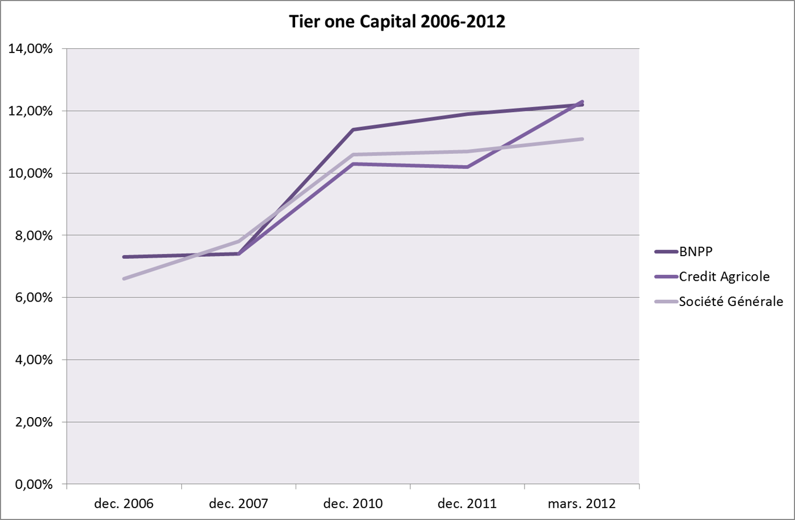

Slide 29
A stable and solid model
In contrast to banking sectors elsewhere, French banks were able preserve positive domestic credit growth (and low credit interest rates) through the whole crisis period (2008 to 2012).
  While lending standards may have been tightened given the slowdown of the economy, the overall softening of credit growth in 2012 is generally attributable to a shift in demand rather than supply.
  However, given ongoing balance sheet adjustments, domestic credit growth may be constrained in the event of an upswing in demand. Banks considered that the impact of their external deleveraging had been muted by the fact that other financial institutions were able to step in quickly into the areas vacated by them.

Slide 30
A stable and solid model
  Add ons for systemically important financial institutions (SIFIs) in France have not been disclosed by regulators, but standards are not expected to be the highest in Europe.
  Most French banks are therefore targeting higher capital ratios by retaining a large part of their earnings, starting in 2010.

Slide 31
The French banking system at a glance
A stable & solid model
Arab banks

Slide 32
Arab banks
The Arab banking systems are relatively young
  They have undergone major improvements and developments during the last decade
Arab banks are already regionally and internationally implemented
  Inside the Arab world, in Europe and the US, and more recently in Africa and Asia
  Banking in GCC countries vs banking in Mediterranean countries
With a diversified model
  Retail banking, investment banking, Islamic finance

Slide 33
Arab banks
A highly dynamic sector
  Arab banks grow faster than Gross Domestic Product
+3,1% in 2011
+4,8% in 2012
(The World Bank)
+15% in Qatar
+24% in Saudi Arabia
+8% for Attijariwafa Bank
between 1S11 et 1S12

Slide 34
Arab banks
The Arab banking systems have undergone the third phase of reform, leading to international integration
And thus to a convergence towards international standards and practices…
  Capital standards : Basel 2 and Basel 3 (BCBS)
  Risk management
  IFRS
  Governance
… and products adapted to emerging markets and economies
  Retail banking : ATM, card payments, etc / Mobile banking

Slide 35
Arab banks
They share the same difficulties than other regions
  SMEs funding
  Financial inclusion
  Financial education
They do Islamic banking, but in competition with conventional banking
  34% of financial assets in Saudi Arabia vs 8% in Oman
  Less than 5% in Maghreb countries

Slide 36
Conclusion
  The French banking model has proven its particular resilience during the financial crisis.
    ➔ There are many French best practices which should empirically inspire the Iraqi reforms
  The French banks have entered a phase of consolidation, focused on their core business, retail banking and France/Europe
    ➔ The neighboring Arab banking systems are important sources of best practices and experiences in that matter
  No more “one size fits all” model but pick the best practices around the globe

